Slide 1
GW Data Workshop
Data Visualization in R
Thursday, November 17
http://tiny.cc/datavizr

Slide 2

About
Statistical programming language
Great for data analysis, predictive modeling, and data viz
Completely free!
Better than Python

Slide 3

How do I even use R?
First, you must install it
https://cran.r-project.org/
Ok now what?
You need an IDE (Integrated Development Environment)
RStudio!
https://www.rstudio.com/
RStudio is where you will write R code
User-friendly way to run R
There are other IDE’s, but not using RStudio is just plain weird

Slide 4
A few data types
Vectors:
The most basic data type in R
A collection of data elements
Factors:
Created from vectors
Stores the vector and each distinct type as a label
Data frames:
Tabular objects consisting of columns and rows (tables, Excel spreadsheets, etc.)
Others include:
Arrays
Matrices
Lists

Slide 5
A few more R things
Indexing/Looping:
Unlike most programming languages, R begins “counting” at 1 instead of zero
This is just how normal people count. Every other programming language is wrong.
Example: x <- c(1,7,3,8)
X[1] = 1
X[2] = 7
In other languages, x[0] would be the first element (1). But R is diffeRent.

Slide 6
Data Viz Guidelines
The best visualizations are simple, neat, and to the point
Overly complicated visualizations are a pain to look at
NO PIE CHARTS
Seriously, just no
NO 3D PIE CHARTS
For the love of god, no
That’s about it
And don’t use Excel

Slide 7
Demo!

Slide 8
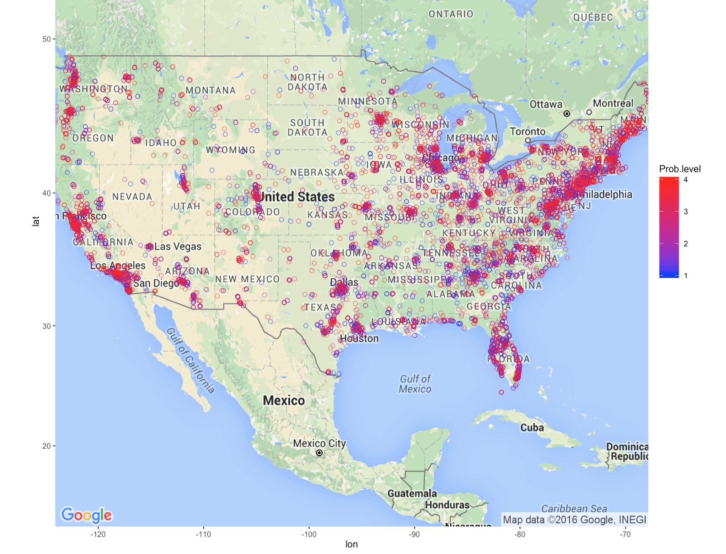
Some visualizations I’ve done

Slide 9
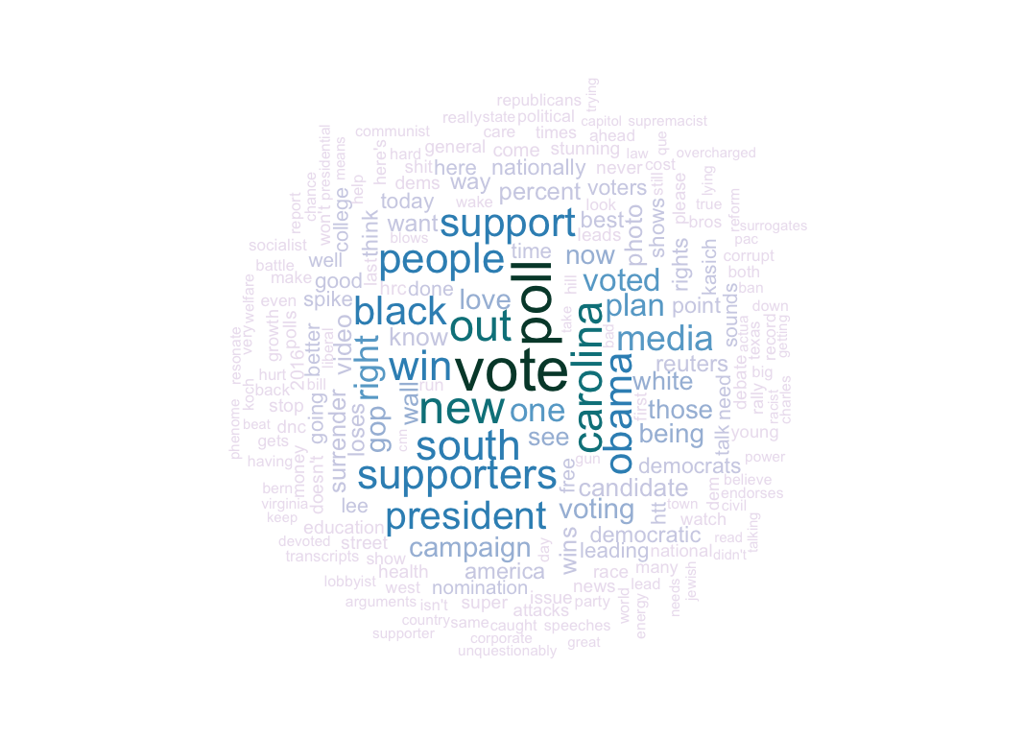
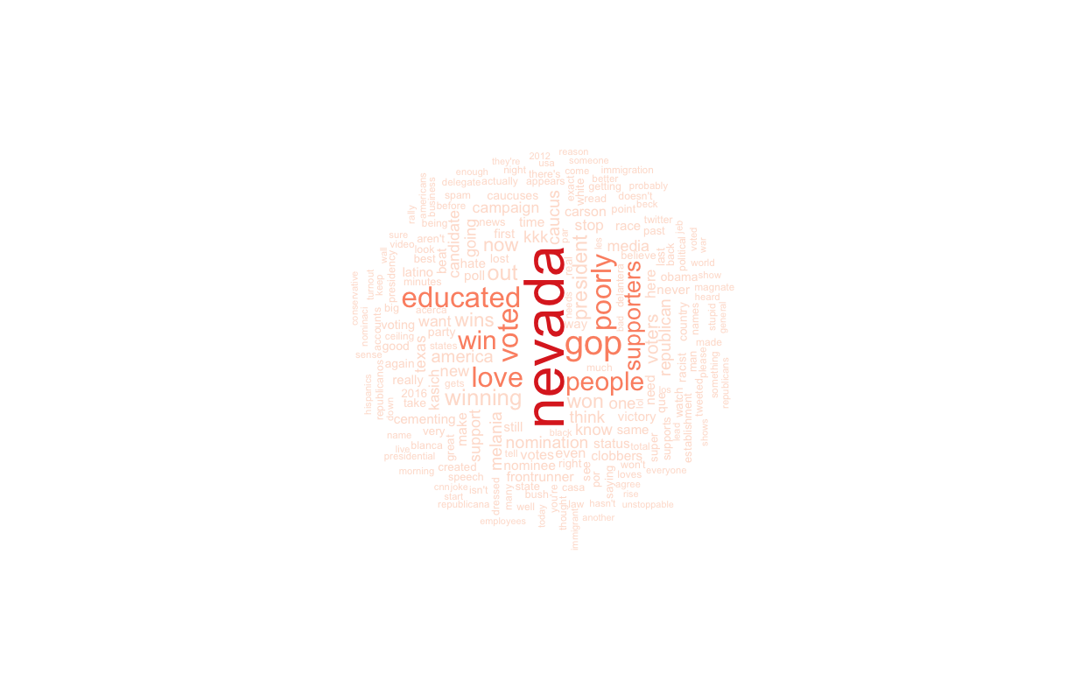
Some visualizations I’ve done

Slide 10
Thanks for coming!
Questions? Comments?

